Slide 1
RTI training
Alison Owens

Slide 2
Objectives
Response to Intervention (RTI)
Oklahoma Tiered Intervention System (OTIS)
What is RTI?
Why is RTI important?
How you can implement RTI in your classrooms.

Slide 3
What is RTI???
RTI is a method of academic intervention used in the United States to provide early, systematic assistance to children who are having difficulty learning.
RTI seeks to prevent academic failure through early intervention, frequent progress measurement, and increasingly intensive research-based instructional interventions for children who continue to have difficulty.

Slide 4
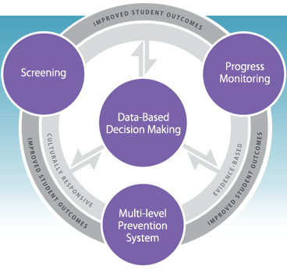
Notes:
Integrating assessments with instruction within a multi level system.
Screening –identify students at risk for academic difficulty
Progress monitor-to determine how well the student responds to instruction

Slide 5
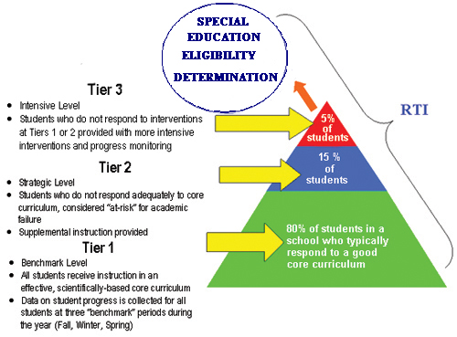

Slide 6
Tier 1 Instruction
75-80% of students respond to research based, high quality instruction, including differentiated small group instruction.
A minimum of 120 minutes should be devoted to ELA classroom instruction in first grade.
In second and third grade student should receive at least 90 minutes of ELA instruction.
Notes:
In order to meet the needs of those students a core curriculum must be well matched to the student population.

Slide 7
Tier 1 instruction
Small group targeted instruction as well as whole-group instruction.
Classroom teachers gather screening and progress monitoring data, participate in data analysis meetings and collaborate to solve instructional problems

Slide 8
Tier 2 Instruction
Targets students who are in the lower 20-30% of the class.
Often given in small groups of about 5 well matched students.
Targeted intervention usually designed for 30 minutes lessons, given in addition to the core curriculum of Tier 1.
Small group instruction should be carefully designed to target areas of academic weaknesses that are determined by screening and progress monitoring
Notes:
Walk to read time

Slide 9
Tier 3 instruction
Usually refers to the intensive instruction
Very small group (1-3 students) instruction for well matched students is delivered for as much as two hours daily to accelerate student’s progress
Alternative programs and curricula that employ special methodologies may be necessary
Assessments are more frequent

Slide 10
Why do we need Response to Intervention?
Children of the Code: Emotional Danger
http://www.youtube.com/watch?v=KjLo5RqTnzA

Slide 11
Why do we need response to intervention?
Reading Sufficiency Act
If a student’s reading deficiency is not remedied by the end of third-grade, as demonstrated by scoring at the Unsatisfactory Level on the reading portion of the OCCT or OMAAP, in 2013-2014, the student shall be retained in the third-grade.

Slide 12
Total Students In Each Grade & RSA At Risk
Grade | Year | 2008 | 2009 | 2010 | 2011 | 2012
K | Total Students | 49298 | 50491 | 51026 | 52101 | 53044
 | October | 18871 | 18769 | 18824 | 19061 | 20384
 | April | 9121 | 8720 | 8617 | 8851 | 9857
1 | Total Students | 51527 | 51533 | 52443 | 52415 | 53135
 | October | 16749 | 15359 | 15647 | 16220 | 19120
 | April | 8212 | 6802 | 7663 | 7878 | 8882
2 | Total Students | 48371 | 48669 | 49155 | 50065 | 50084
 | October | 17757 | 17512 | 17852 | 17809 | 19024
 | April | 9659 | 7956 | 9403 | 9422 | 10056
3 | Total Students | 47274 | 48049 | 48591 | 48883 | 49519
 | October | 16107 | 16221 | 16343 | 16644 | 17590
 | April | 8866 | 7789 | 8694 | 8842 | 9012
Notes:
30 minutes of additional instruction for every grade level a student is behind for “catch up”

Slide 13
Data collection tools
Resources to help schools select reliable, valid tools:
studentprogress.org
rti4success.org
RTINetwork.org
Easycbm.com
Interventioncentral.com
ADD FLORIDA

Slide 14
How data is used for selecting interventions
Look at students with similar data profiles, indicating very specific instructional needs:
Link those data with that group of students – both differentiating that within the general classroom and providing supplemental or “tier time.”
Tier time: extra time during the school day when students who are behind can actually get intensive interventions to accelerate learning so they can catch up.

Slide 15
Final thoughts with Dr. Lynn Fuchs
Our goal is to identify those who are at-risk for long-term serious consequences.
RTI is an important mechanism to enable general and special education to work proactively and collaboratively together with the goal of preventing children from exiting school without the academic skills they need to lead successful, healthy lives.

Slide 16
Goal
To reduce long-term negative consequences that happen when students fail to learn in school.

Slide 17
Thank you!
owensandhall.reac3hcoach.weebly.com

